Slide 1
A Statewide Analysis of Vaccines in the COVID-19 Pandemic
Group 8: Emma Oriol, Dana Kamenz, Jeffrey Ochavillo, Gokula Chandra Kulala.

Slide 2
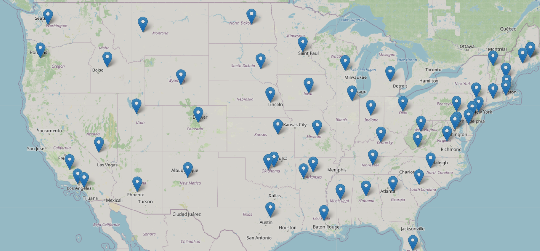
COVID-19 In the United States
1,000,000+ deaths to date
First US case detected January 2020
Pandemic response has included masking, social distancing/lock-downs, and vaccination, with large variations between states
Goal: Learn from the data we have about COVID-19 to better plan and prepare disease control responses

Slide 3
Investigative Questions:
How does access to vaccine providers, vaccination rates, and death and case rates vary across states?
Do higher vaccination provider densities correlate with high vaccination rates by state?
Do more vaccines administered correlate with lower death rate?
How did masking and lockdown phases affect death rates?
How does this inform pandemic response best practices?
Notes:
We are investigating these questions to understand how vaccine provider density, vaccination rate, cases, and deaths have varied by state. We are also looking at COVID death rates before and after masking and phases of lockdown to understand their effectiveness. Our goal is to connect these questions to understanding best pandemic response practices in the United States.

Slide 4
Data Sources
5 main data sources: Vaccines.gov, CDC COVID Data Tracker, CDC COVID Cases and Deaths, COVID-19 US State Policy, and 2020 Census
Database sizes vary; can contain only snapshot or historical data
Databases reported by government agencies (CDC and Census Bureau), however almost all rely on data that were collected by states
Generally trust these government agencies to produce quality data
After collecting data from states/local agencies, CDC then compiled the data into a consistent format to store in a single database
True extent of informed consent among people is unknown; practices vary between states
Data reported at a population level, so PII is not present in these databases (excluding Census)

Slide 5
Methods of Analysis
Visualization of data through bar plots as early data exploration
Simple linear regression
Correlation ( Heat map)
Notes:
Our method of analysis is fairly simple and straightforward .
Through visualizations of bar plots, simple linear regression, and correlations from heat maps we looked to use the relationship or correlations to gain any insight between vaccines administered, # vaccine providers, covid death rates, and policy changes in time against all 50 states.

Slide 6
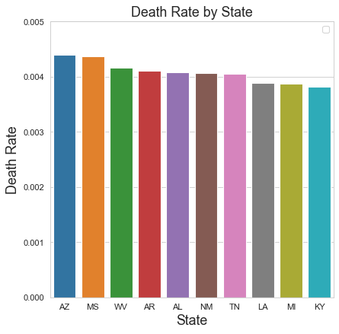
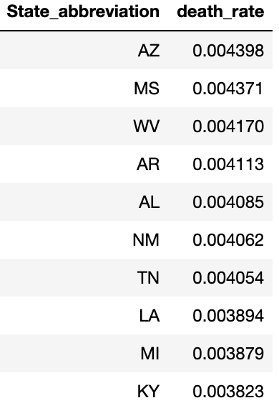
Top 10 States with Highest COVID-19 Death Rate
Notes:
If you were to look at the Overall cases and death per state, it’s noticeable that all the states with the bigger population have the highest cases and deaths.
But with consideration for population, it’s not the case here where we see some smaller states having a higher death rate. I would think just based on our general knowledge and seeing of COVID, I instantly assumed covid death rates were higher in other places and not in the top 10 listed above.

Slide 7
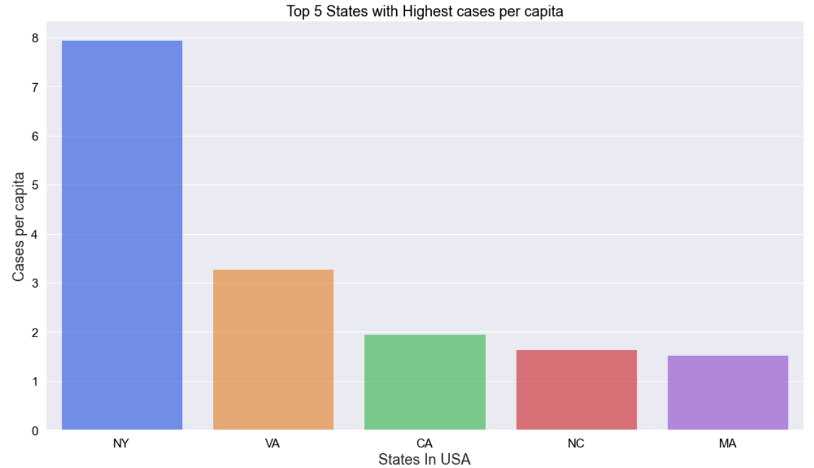
Top 5 States with Highest COVID-19 Cases Per Capita
Notes:
Here this graph tells us about the top 5 states, recorded with highest no of cases. And also here we are primarily considered about the positive cases per capita(Confirmed cases,it compares the proportion of positive instances to the population in a given area(State)).

Slide 8
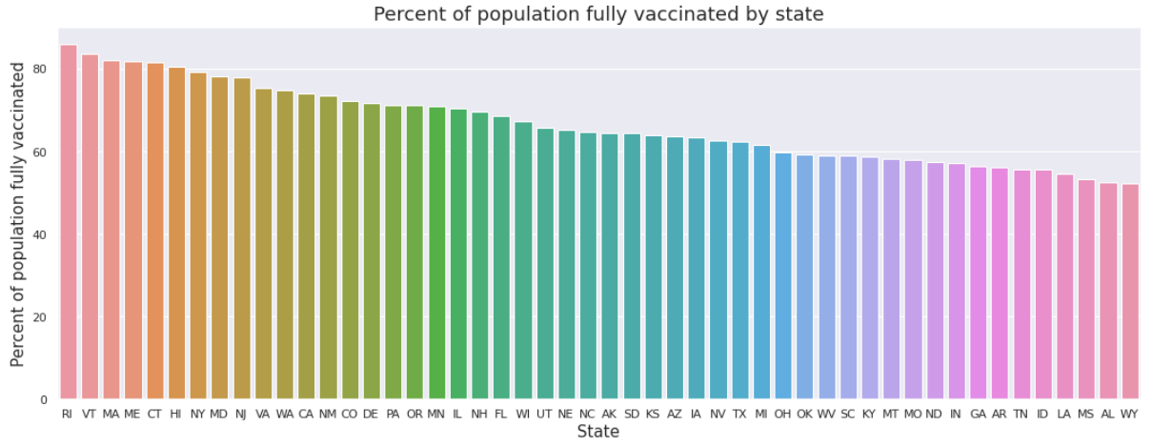
What states are the most/least vaccinated?
Notes:
There is a large range of vaccination rates between the highest and lowest vaccinated states.

Slide 9
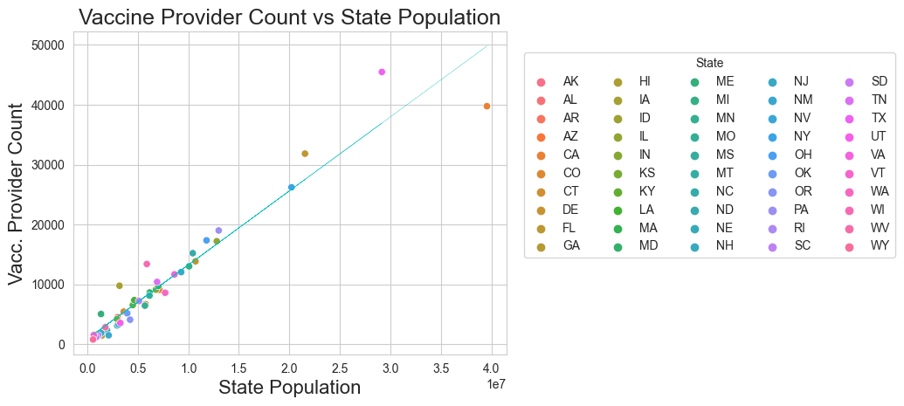
Vaccine Provider versus State Population
TX
CA
FL
NY

Slide 10
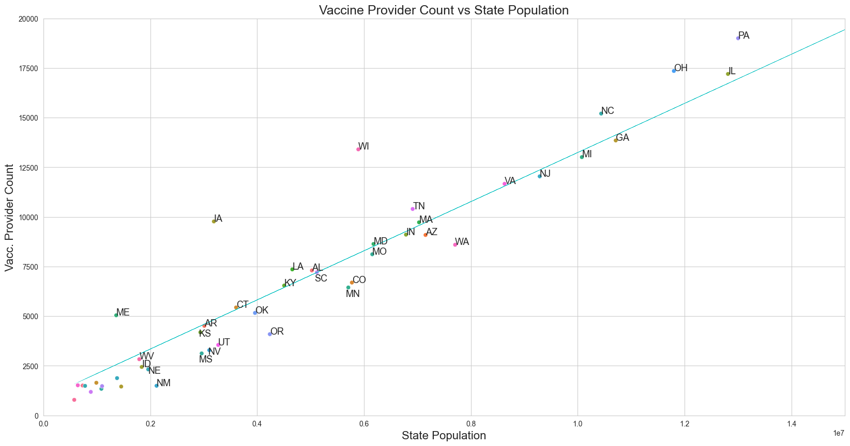
Vaccine Provider versus State Population (Zoomed In)
WY
VT
AK
ND
SD
DE
MT
RII
NH
HI

Slide 11
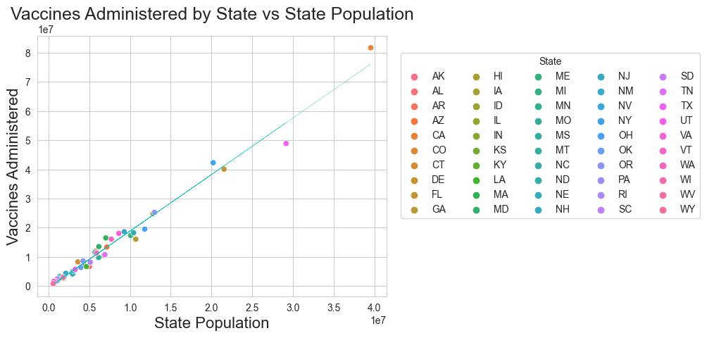
Vaccines Administered vs State Population
CA
TX
NY
FL

Slide 12
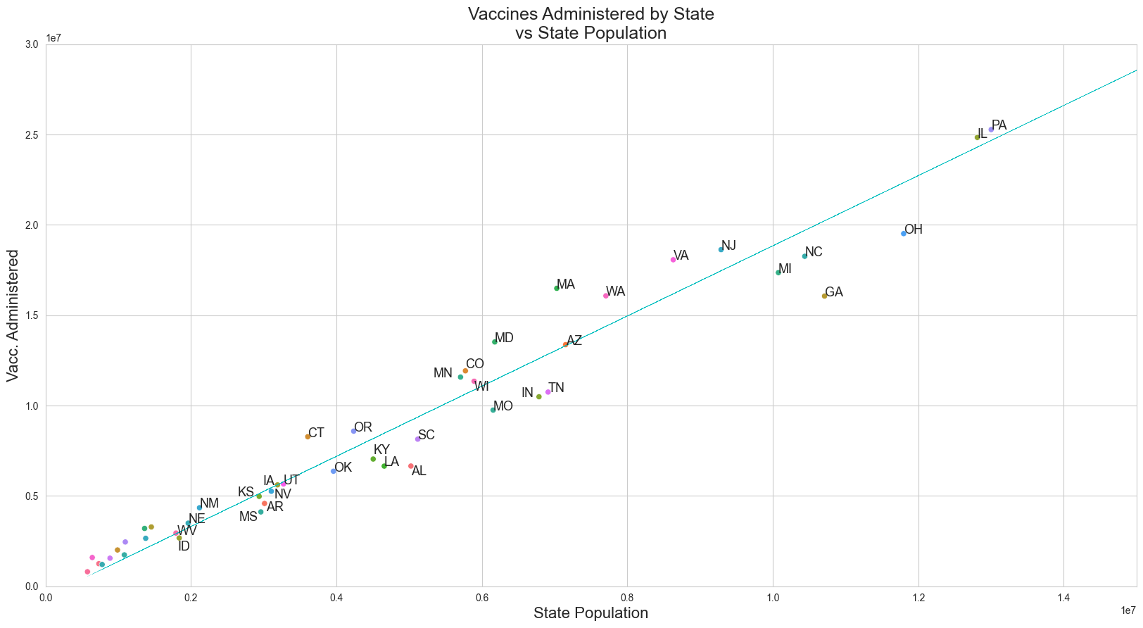
Vaccines Administered vs State Population (Zoomed In)
WY
VT
AK
ND
SD
DE
MT
RII
ME
NH
HI

Slide 13
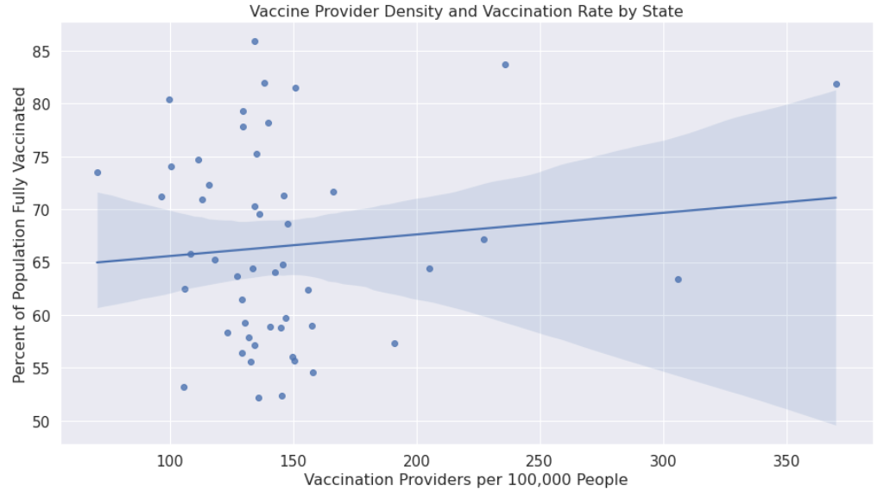
Regression Plot between Vaccine Provider Density and Vaccination Rate
Notes:
No clear increase in percent of people getting vaccinated based on vaccine provider availability. This implies the availability of vaccine providers is not a limiting factor for vaccination. I.e. if people aren’t getting vaccinated, it’s not necessarily due to lack of availability.

Slide 14
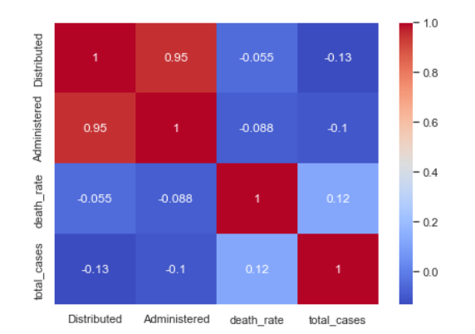
Correlation Between Death Rates, Vaccines, Cases
Notes:
Association between total_cases & deaths has a +ve correlation here (As total cases increases the death rate increases)
Association between Distribution & Total cases has a -ve correlation here (As Distribution increases the Total cases decreases)

Slide 15
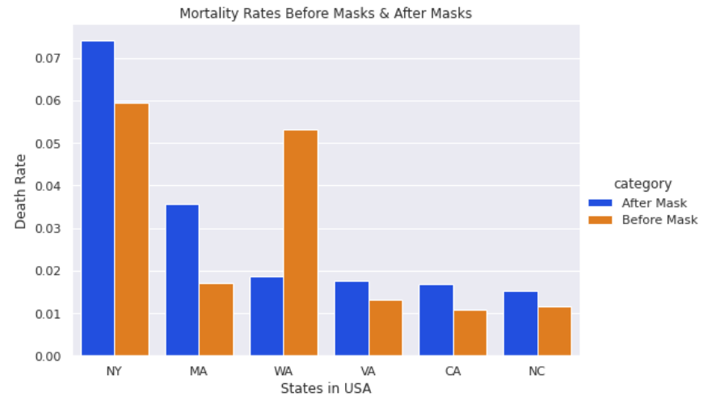
BEFORE MASK AND AFTER MASK MANDATE
Notes:
With consideration with states having varied dates for mask policies, we did take the latest date for our analysis. What we can see here is that after the masked mandates were lifted, we started to see that many states had increases in their death rates. While some decreased. We cannot say exactly here that because of the mask mandates were lifted was the reason why death rates increases but it surely it something as consideration. This doesn’t speak on behalf of the whole US because some states may have experienced covid earlier and mandates very masks vary from state to state.

Slide 16
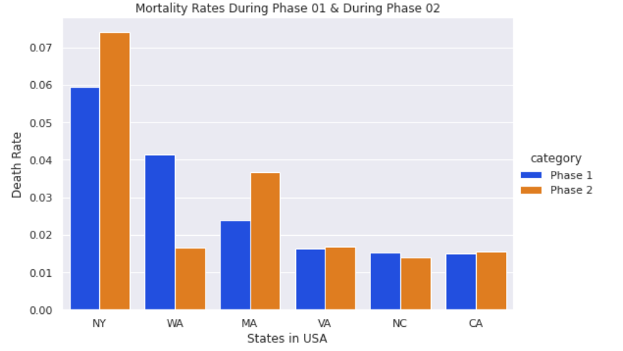
COVID PHASE 01 AND PHASE 02
Notes:
So when we were looking into the phases, phase 1 being the start of closure of business and lockdown, and the start of reopening of business which was around june 8th which is phase 2
We can see that for the states we listed, the deaths rates were low, considering it was the start of the pandemic and we were in quarantine and this was without the vaccine at the time.
But after phase 2 deaths rates started to increase. This doesn’t speak on behalf of the whole US because some states may have experienced covid earlier and some states vary for their closure policies.

Slide 17
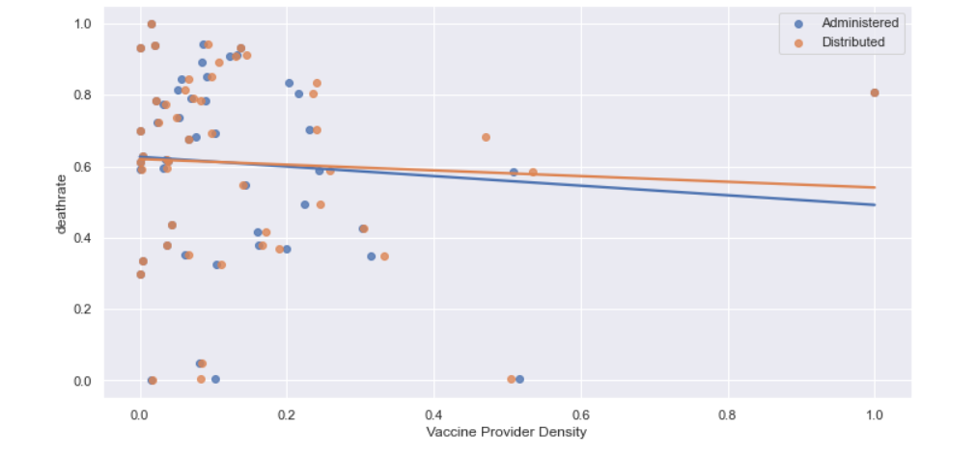
Vaccine Provider Density vs Mortality Rate
Notes:
Death rates slightly started to decrease as and when vaccine provider density started to increase.

Slide 18
Conclusions and Takeaways
Burden of COVID-19 varies by state- large variation in vaccine providers, cases, death rates, and vaccination levels
Increasing vaccination rates should be a focus of pandemic response
Increased vaccinations associated with lower death rates at the stste’s population level
There is a evidence that increased vaccine providers is correlated to death rate
Evidence does support that increasing vaccine provider density would improve the pandemic response
Death rates for COVID increased in “Phase 2”
Suggests that stricter lock down rules correlates with reduced COVID deaths
Lock downs may be an effective pandemic response in the immediate for reducing deaths but more data is needed to understand causality
More research and data needed to understand the efficacy of masking

Slide 19
Data Sources:
Vaccines.gov
Data about COVID-19 vaccine provider locations
Data includes location, vaccine stock, hours of operation, etc.
Some data values are missing, but each vaccine provider does have location information available
Data is up-to-date (as of Oct 18)
Does not contain historical information
Over 455,000 rows of data entries
CDC COVID Data Tracker Cases, Deaths, and Testing
Collection of COVID-19 data including cases, hospitalizations, deaths, etc. by state
Over 36,000 rows of data points
Data sourced from the CDC, collected through self reporting from each state
Very little missing data/data cleaning needed
Missing data was removed
Each state has its own data collection practices- assumed informed consent maintained
All data anonymized

Slide 20
Data Sources:
CDC United States COVID-19 Cases and Deaths by State over Time
Collection of historical data since 10/18/2022
Reported by CDC, relying on data from state sources
60,000+ data entries
United States Census Bureau
Extensive demographic data of American population
Numerous attributes of American population recorded, only state populations used for this project
Data collected from reporting by every American household
2020 Census collection was impacted by COVID-19, may be less accurate than previous decades
Data compiled and presented by US Census Bureau
Americans needed to willingly provide information
Data presented at population level, and PII is protected for 72 years

Slide 21
Data Sources
The COVID-19 US State Policy (CUSP)
Collection of data to understand how policies impact population health and health equity in the US
Reported information on when Closures and Reopenings and Mask mandates within the US states overtime.
Dates included were dates before and after 04/08/2022 for Mask Mandates and dates before and after 06/08/2022 for Closure and Reopening of businesses.
However some states did not have any dates recorded

